Slide 1

Hand Gesture Recognition
Using Haar-Like Features & SCFG
20
22
Presented by:
Mubtasim Fuad Mozumder
20101463
CSE424 [Task- 02]
20
22

Slide 2
01
Introduction
20
22
20
22

Slide 3
20
22
Introduction
Text-based to VE systems: Progression of interfaces
Hand gestures in VEs: Powerful communication modality
Challenges with traditional glove-based devices
Vision-based recognition: Real-time solutions
Categories: Appearance-based and 3-D model-based approaches
Trade-offs: Real-time performance vs. computational complexities
Current challenges: Lack of speed and accuracy in recognition
Need for innovative solutions: Robust an accessible hand tracking in real-time applications
20
22

Slide 4
02
Two level Approach
20
22
20
22

Slide 5
20
22
Two level Approach
Definitions: ** Static Hand Posture & Dynamic hand gesture sequence
Dynamic Aspect: ** Global and local motions & Gesture as a composite action
Recognition Problem: ** Two levels: Detection and analysis
Image Features: ** Skin color and hand shape with challenges of Object distinction, lighting, computational cost
Statistical Approach: ** Haar-like features ** AdaBoost for accuracy and real-time performance
Syntactic Object Description: ** Overcomes quantitative limitations ** Grammar-based for hierarchical representation
20
22

Slide 6
03
Posture Detection using
Haar-like feature
20
22
20
22

Slide 7
20
22
Posture Detection Using Haar-Like Features
Background: ** Statistical approach with "integral image" and Haar-like features
Features and Integral Image: ** Efficiently encoding domain knowledge with Enhanced speed compared to raw pixels ** Describe dark-bright area ratios within a kernel while Computing pixel sums efficiently ** Achieves true scale invariance, reducing need for multiscale pyramids
AdaBoost Algorithm: ** Used for feature selection and also boosts accuracy while maintaining high speed
Adaptation for Hand Gestures: ** Tested with four postures using cascade classifiers ** Achieved high accuracy (97-98%) for various hand gestures
Robustness and Real-time Recognition: ** Robust against lighting variations ** Background subtraction for cluttered backgrounds ** Achieved real-time recognition with minimal latency
20
22

Slide 8
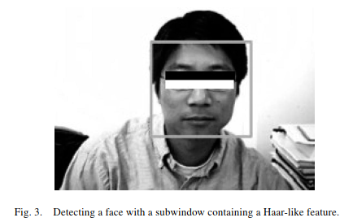
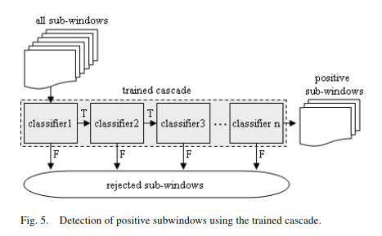
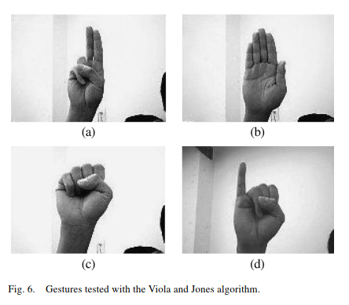
Posture Detection Using Haar-Like Features

Slide 9
04
Gesture Recognition using an SCFG
20
22
20
22

Slide 10
20
22
Gesture Recognition using an SCFG
Gesture Representation: ** Sequences of connected hand postures. ** SCFG for hierarchical gesture structure.
SCFG Overview: ** SCFG: Four-tuple structure (VN, VT, PS, S) while using previous SCFG applications in activity recognition.
SCFG vs. HMMs: ** SCFG's flexibility compared to HMMs. Also SCFG is suitable for diverse gesture modeling.
Implementation: ** SCFG for hand gesture representation with three gestures generated: "Grasp," "Quote," "J."
Probability-Driven Recognition: ** Assigning probabilities to production rules. ** Controls recognition, reduces "unwanted" gestures.
Flexibility and Extensibility: ** SCFG's flexibility for diverse gestures and has potential extension for complex gestures.
20
22

Slide 11
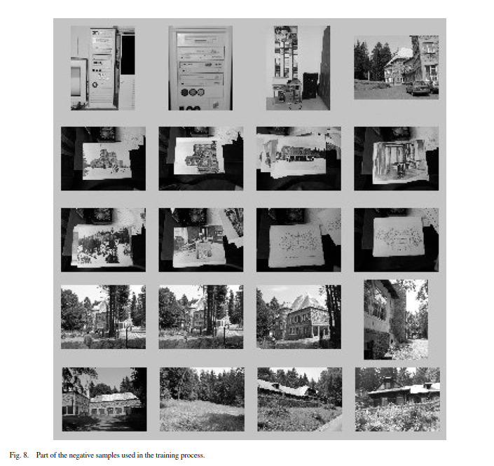
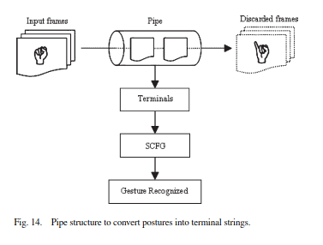
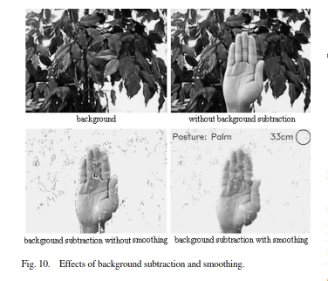
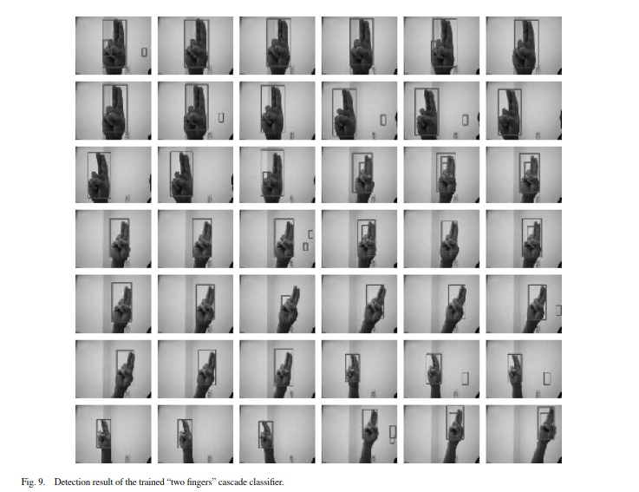
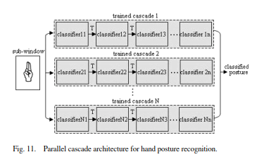
Gesture Recognition using an SCFG

Slide 12
05
Conclusion
20
22
20
22

Slide 13
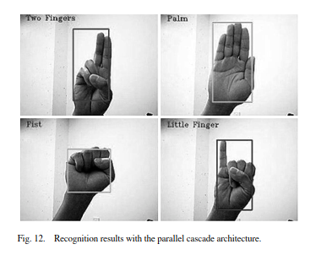
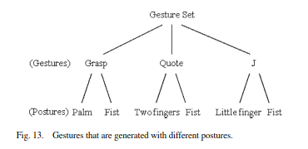
20
22
Conclusion
Two-Level Approach: ** Low: Haar-like features + AdaBoost. ** High: SCFG for syntactic analysis.
Low-Level: ** Effective Haar-like features with AdaBoost for strong classifier.
Parallel Cascade: ** Trained classifiers for real-time recognition along with high accuracy and speed.
High-Level SCFG: ** Converts postures to strings. ** Identifies gestures with probabilities.
Contributions: ** Real-time accuracy & flexible gesture control.
System Validation: ** Successful real-time recognition..
20
22

Slide 14
Thank You
20
22
20
22

